Slide 1
Data Inc. 5000 Homework
Notes:
Hello everyone
Today I am going to present various visuals from the data given to us about the Inc. 5000

Slide 2
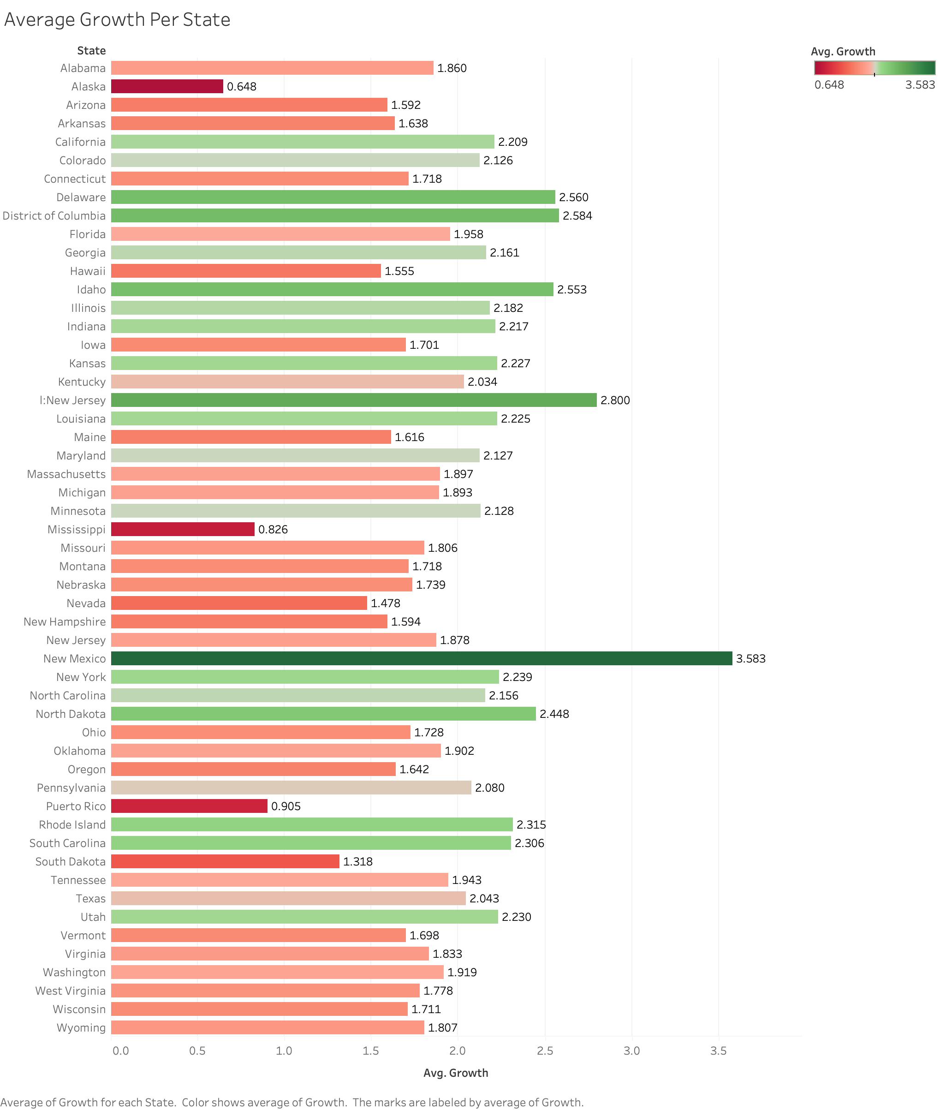
Notes:
This horizontal bar graph shows the average growth per state in the United States, with New Mexico having the highest Average growth of 3.58 and Alaska having the lowest Average growth of 0.648.

Slide 3
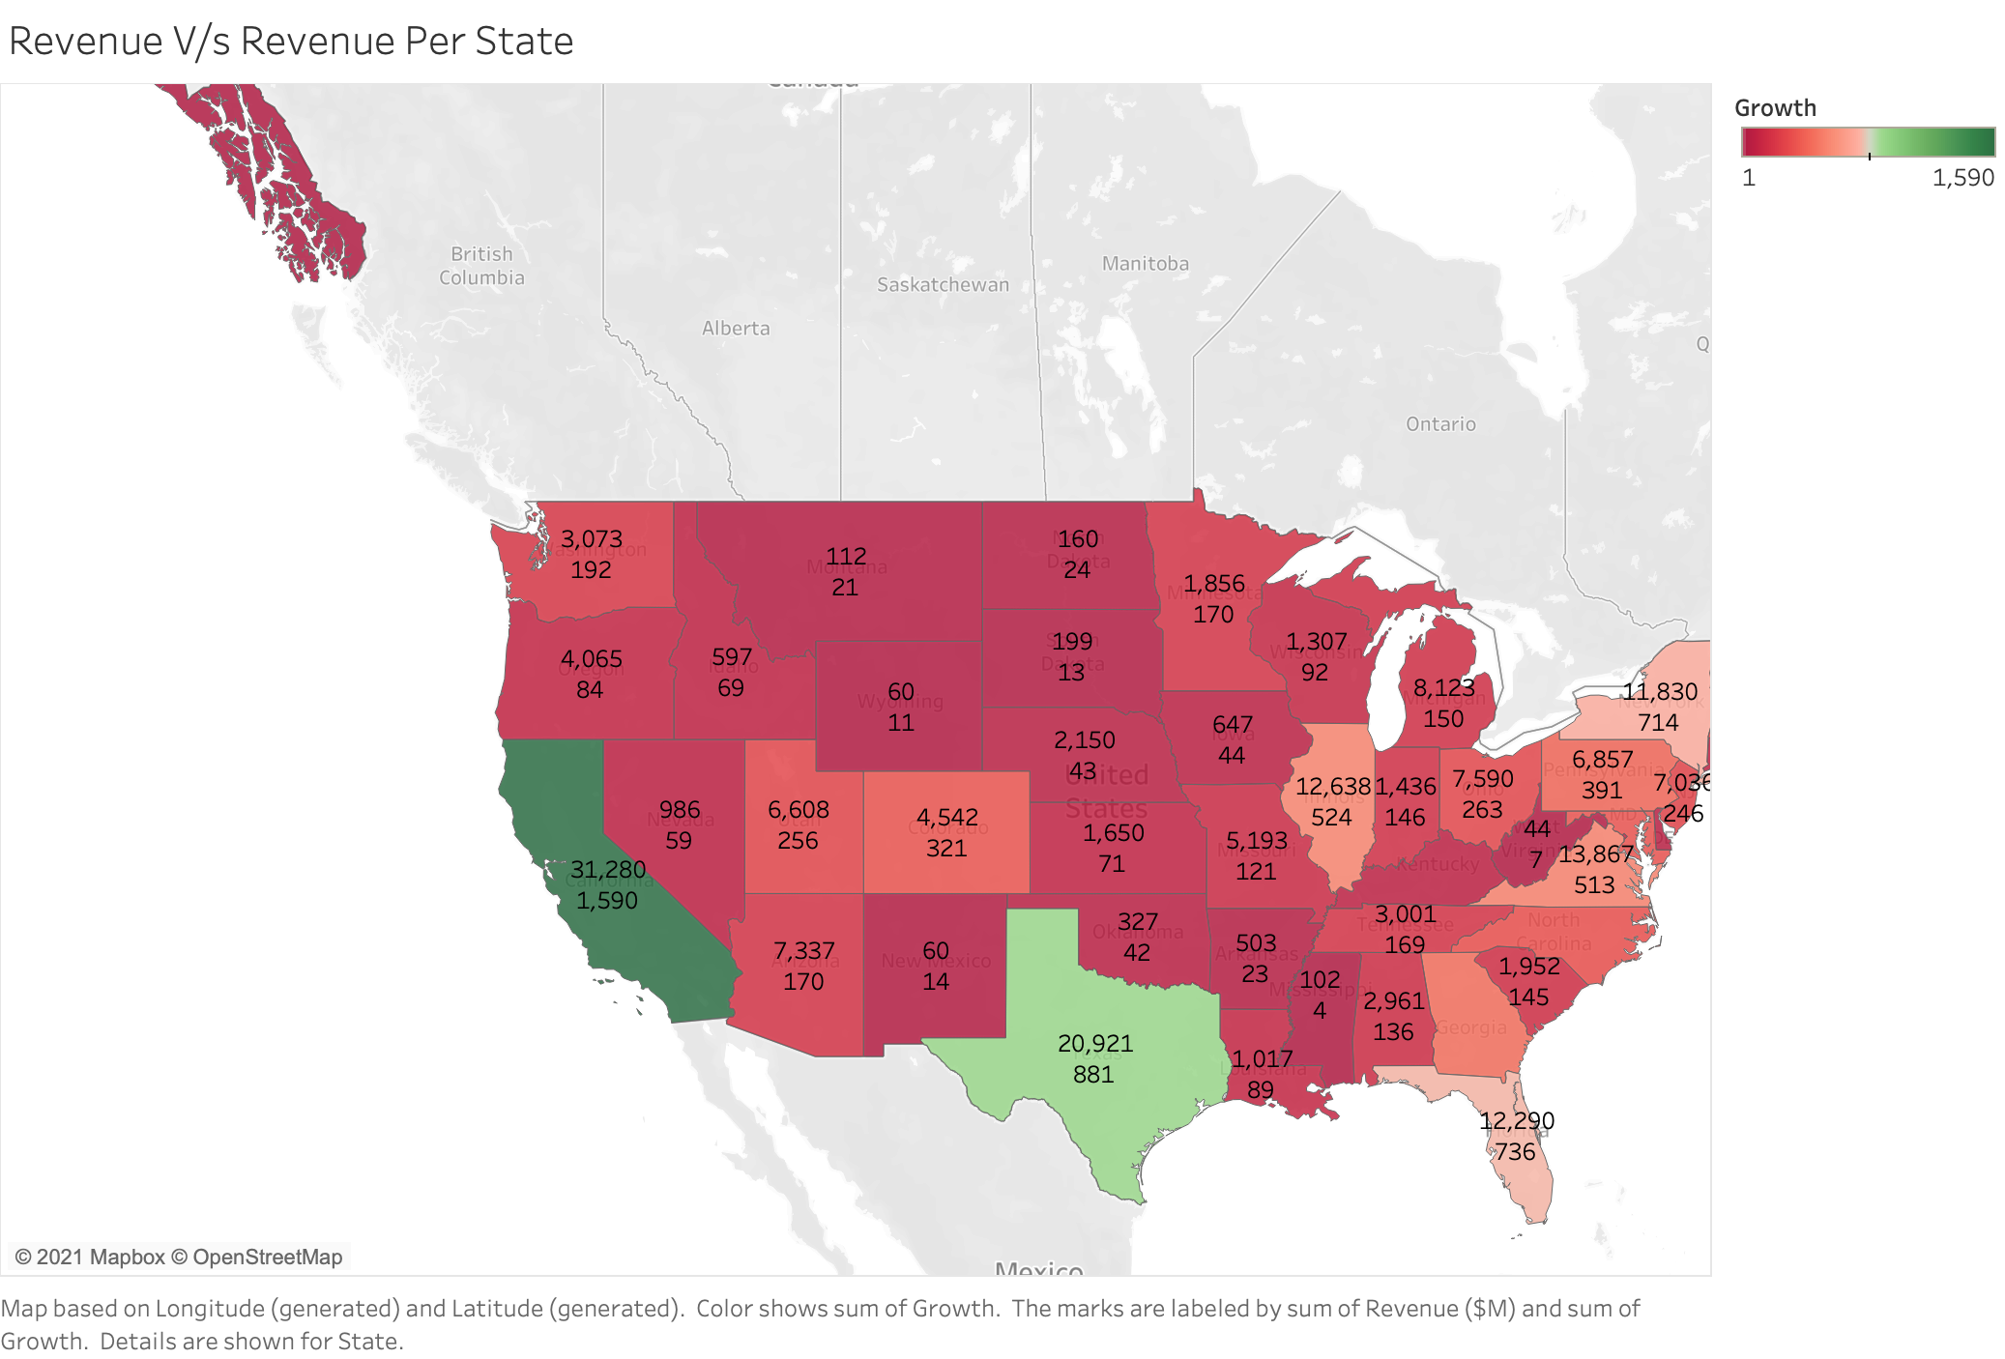
Notes:
The shown symbol map shows the relationship between Revenue and Growth per state. For instance, the Revenue at Washington is $3073 M, whereas the growth is 192. So, it shows that if a state has high revenue, that does not necessarily mean that that it has the highest growth.

Slide 4
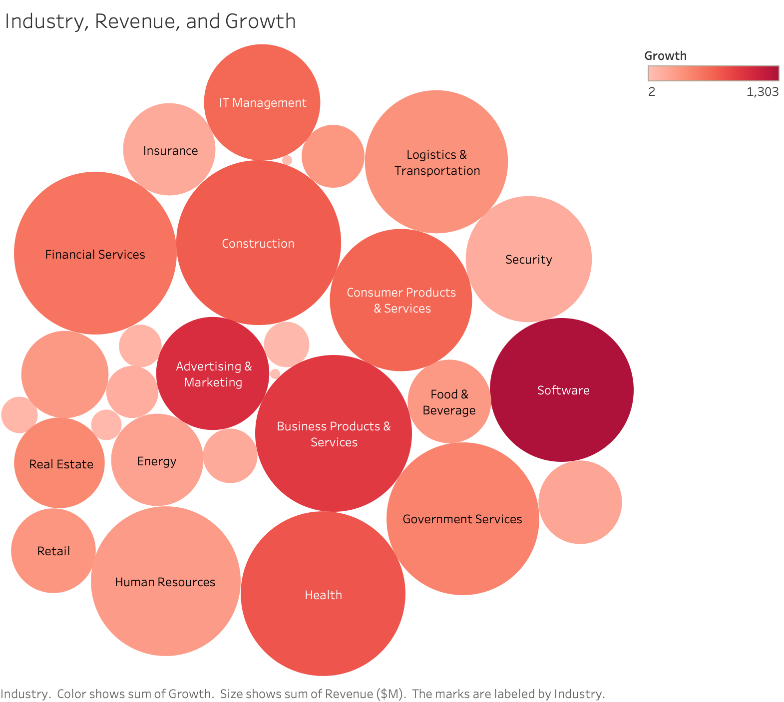
Notes:
This bubble chart shows each separate industry along with its respective revenue and growth. As per the size, Construction industry has the maximum revenue of $17559 M, and Software leads in growth, which is 1303.

Slide 5
Notes:
This graph is not so clear on the PowerPoint slide, but if we look at the visualization in Tableau, we can see that the city New York has the maximum number of companies on the list which is 177.

Slide 6
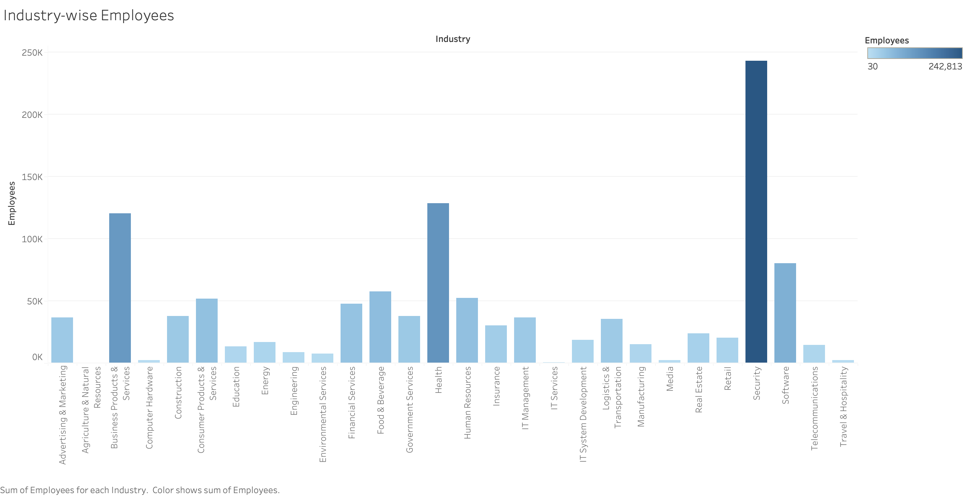
Notes:
Each industry’s need of employees is different, so the number of employees in multiple industries range from 30 in Agricultural & Natural Industry to 242813 in Security Industry.

Slide 7
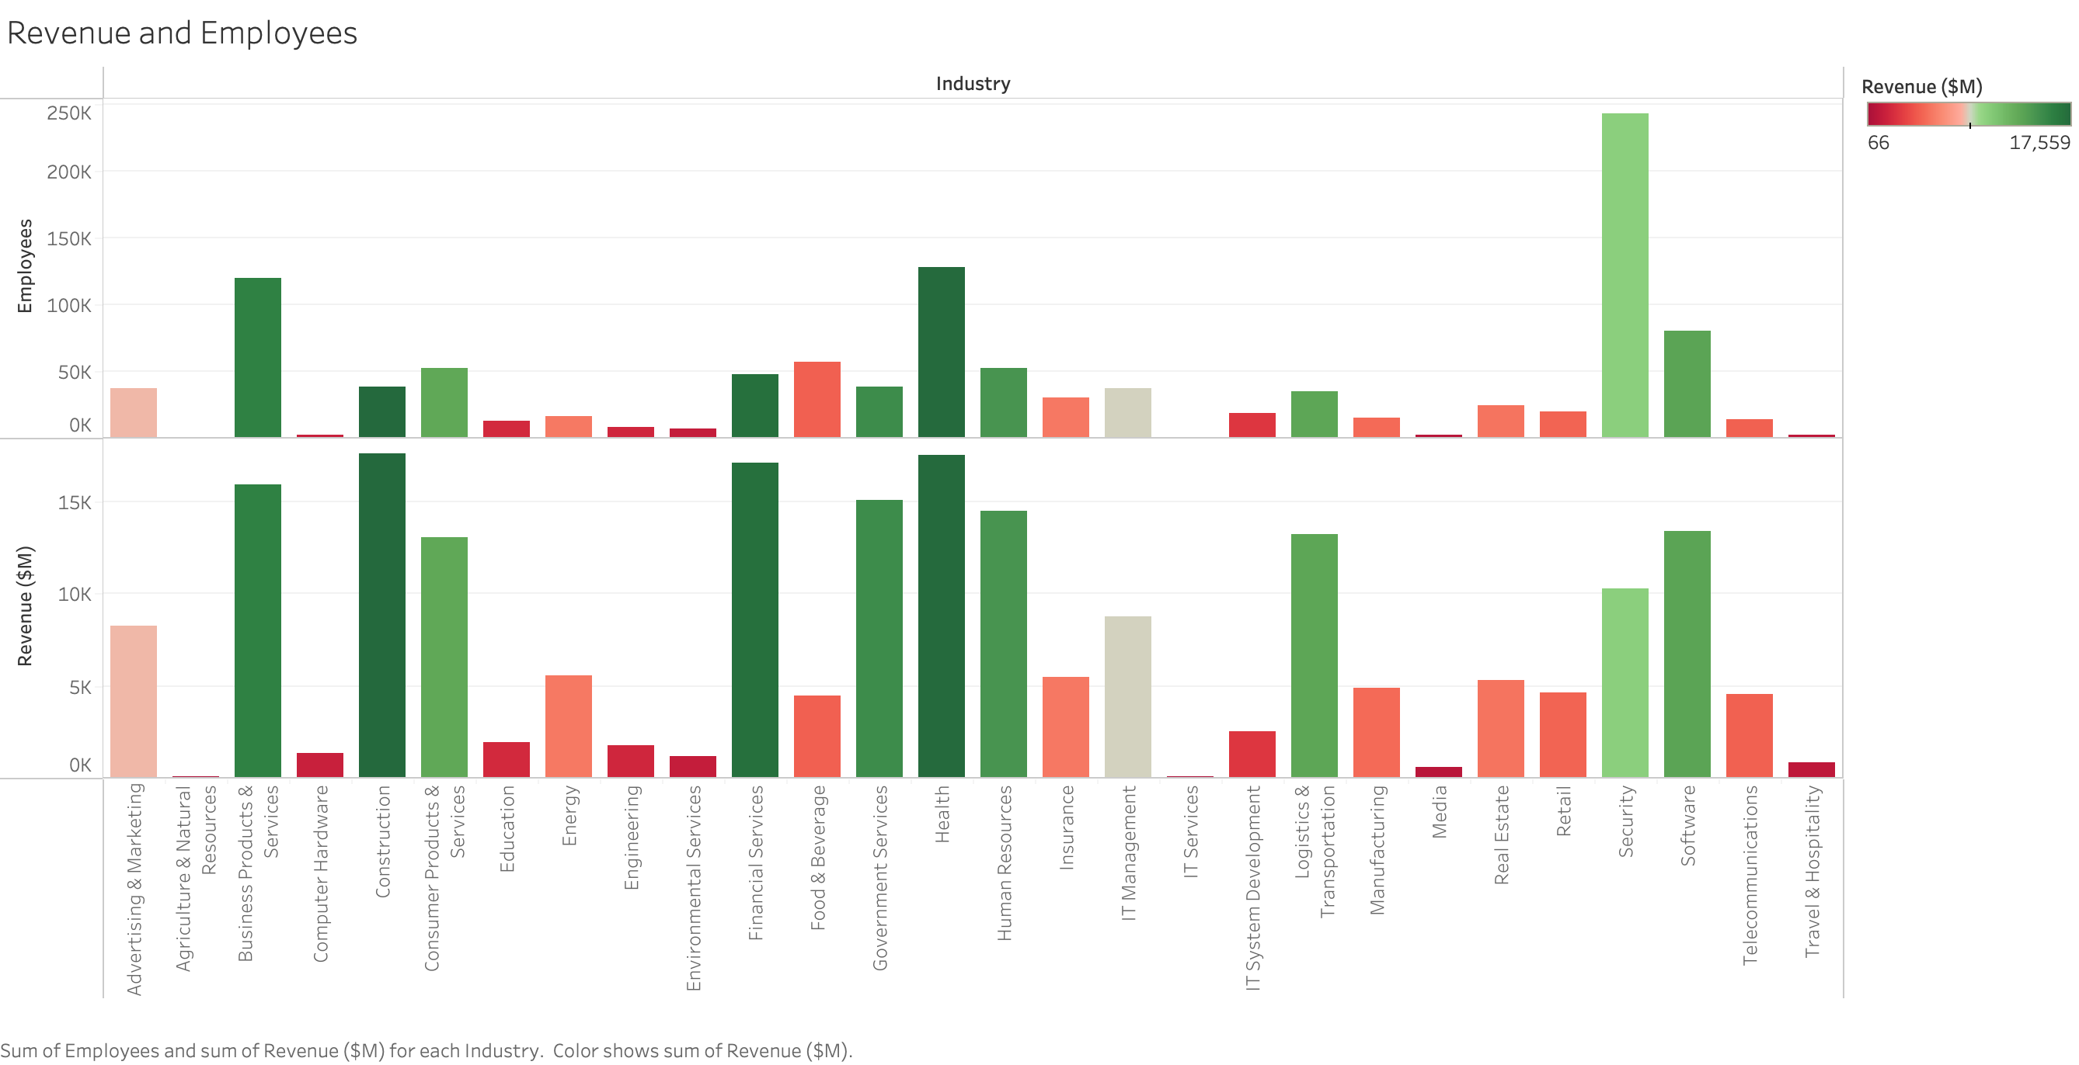
Notes:
In the given visual representation, we can see that revenue and number of employees are not directly related, i.e., Security industry is seen to have the highest number of employees, whereas highest revenue is seen in the Construction industry.

Slide 8
Notes:
This visualization shows a comparison between Texas and Ohio in terms of number of employees in different industries
As the graph clearly represents, Texas leads the most in Health industry and Ohio leads the most in Financial Services.

Slide 9
Thank You Presented by :- Prachi Shah Student at The University of Akron Major - Business Data Analytics and Business Administration

